Slide 1

Computer Graphics
CS C 471 and IS C 471
Dr. Lucy J. Gudino
Computer Science & Information Systems Group
Birla Institute of Technology & Science, Pilani, Goa Campus

Slide 2
3-D Transformations

Slide 3
Problems
Obtain transformation matrix for rotation about the line joining the points (0,0,0) and (1,1,1) with the angle of rotation 45 degrees in counter clock wise direction
A triangle is defined by 3 vertices A(0,2,1), b(2,3,0) and C(1,2,1). Find the final co-ordinates after it is rotated by 45 degrees around a line joining the points (2,2,2) and (1,1,1).

Slide 4
Rotation about Arbitrary Axis
Case II
    If an object is to be rotated about an axis that is not parallel to one of the coordinate axes

Slide 5
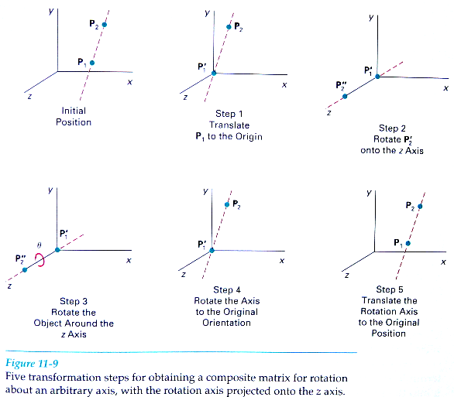

Slide 6
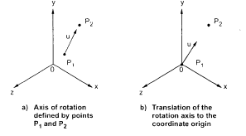
Contd…
  Use following transformation sequence
    Step 1: Translate the object so that the rotation axis specified by unit vector passes through the coordinate origin. ➔ Translate p1 to origin

Slide 7
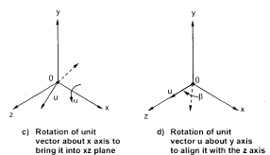
Contd…
  Step 2: Rotate the object so that the axis of rotation coincides with one of the coordinate axes. Usually the z axis.
    To coincide the axis of rotation to z axis we have to first perform rotation of unit vector u about x-axis to bring it into xz plane and then perform rotation about y axis to coincide it with z axis

Slide 8
Contd…
  Step 3: Perform the desired rotation θ about the z axis
  Step 4: Apply the inverse rotation about y axis and then about x axis to bring the rotation axis back to its original orientation
  Step 5: Apply the inverse translation to move the rotation axis back to its original position

Slide 9
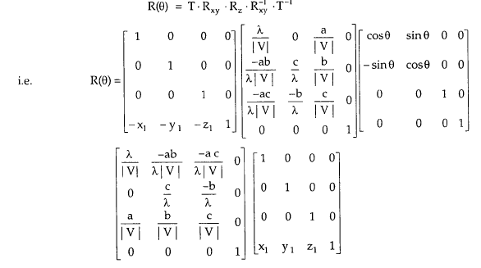
Contd..

Slide 10

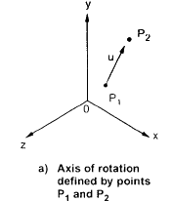

Contd…
The rotation axis is defined with two coordinate points P1 and P2 and unit vector u is defined along the rotation of axis as
Where V is the axis vector defined by two points P1 and P2 as
The components a, b, and c of unit
vector are the direction cosines for
the rotation axis

Slide 11

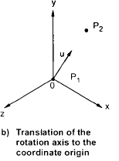
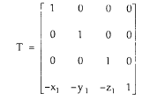
Contd..
Defined as
    Step 1: Translate the object so that the rotation axis specified by unit vector passes through the coordinate origin.
    Move point P1 to the origin.

Slide 12
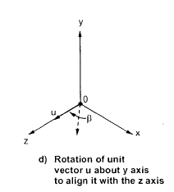
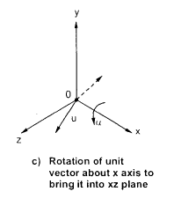
Contd…
Step 2: Rotate the object so that the axis of rotation coincides with one of the coordinate axes. Usually the z axis.

Slide 13

Contd…
The rotation of unit vector around the x-axis in to xz plane is accomplished by rotating u’(0, b, c) through angle α in to the z-axis and the cosine of the rotation angle α can be determined from the dot product of u’ and the unit vector u_{z} along the a axis

Slide 14
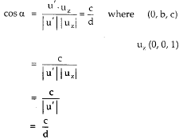
Contd…
where d is the magnitude of u’

Slide 15
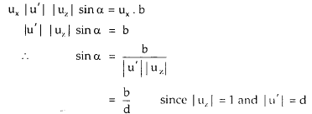
Contd…
We can determine the sine of a from the cross product of u’ and u_{z}
and the Cartesian form for the cross product gives us

Slide 16
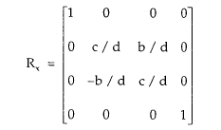
Contd…

Slide 17
Contd..
Step2: Rotation of unit vector about y axis by β
This is achieved by rotating u’’(a,0,d) through angle β onto the z axis

Slide 18
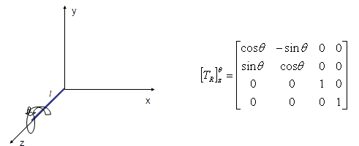
Contd…
Step 4: Rotate about z axis by the desired angle θ

Slide 19
Contd…
Step 5. Apply the reverse transformation to place the axis back in its initial position

